Slide 1

Nixon Bohr
Created by: Jordan fluth and Vernon jones

Slide 2
Inspiration
The idea for this project came after seeing a youtube video of a master’s thesis which used a Microsoft Kinect to control a LEGO NXT brick.
http://www.youtube.com/watch?v=FTBBlt9uk1A

Slide 3
hardware required
A laptop with Bluetooth connection
A Microsoft Xbox Kinect
LEGO NXT Brick
Two TETRIX motor controllers
A TETRIX servo controller
12V battery

Slide 4






Hardware Setup

Slide 5
Software required
Microsoft Windows Operating System
ROBOTC IDE (30-day trial offered)
FAAST
Kinect development software

Slide 6
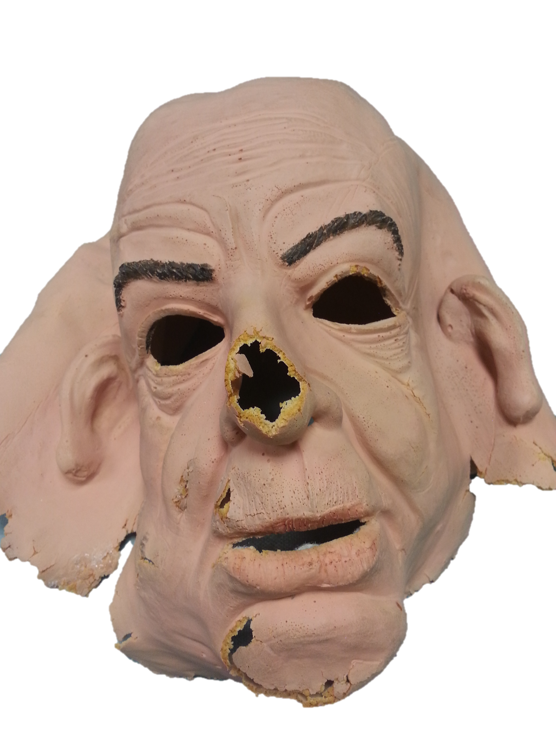
Initial condition of robot
The initial condition was not great. It was a head and shoulders mounted on a motorized platform. All of our motor controllers were missing along with the LEGO NXT brick and the face skin was damaged beyond repair.

Slide 7
Objective
Establish wireless serial communication between the laptop and the LEGO NXT brick over Bluetooth
Program gestures to be recognized by the Kinect and translated into physical movements on the robot for driving operations
Program gestures to be recognized by the Kinect and translated into physical movements on the robot for controlling the arm
Refine motion controls such that we can drive over to an object, pick it up and place it in a desired location

Slide 8
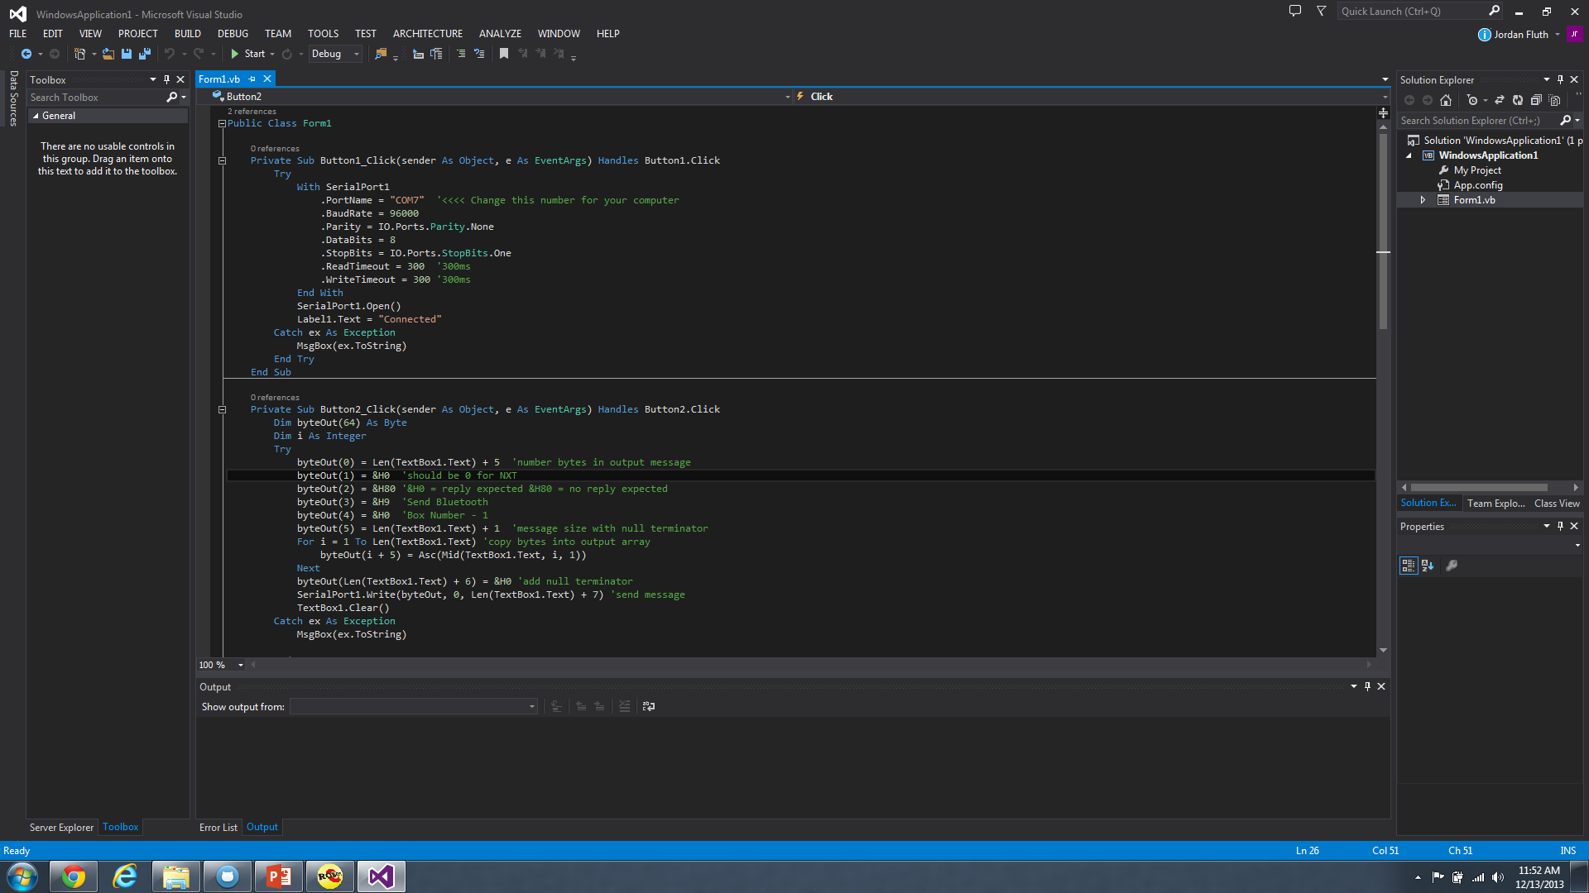
Visual Basic – Connect to BT

Slide 9
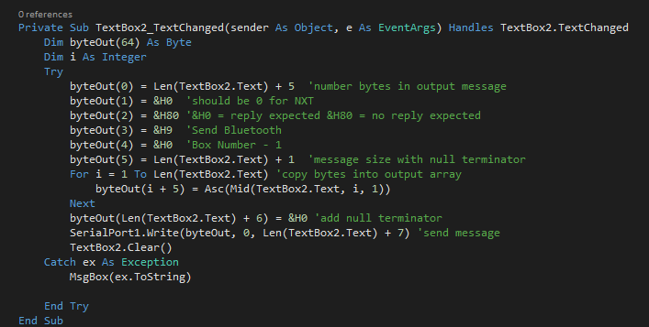
Visual Basic – auto-send character

Slide 10
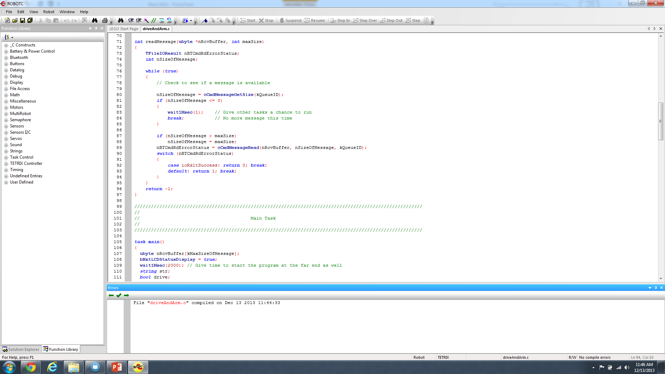
Bluetooth mailbox

Slide 11
Robot control state diagram
w
s
MOVE HAND
MOVE ARM
MOVE WHEELS
w’
s’
s’

Slide 12
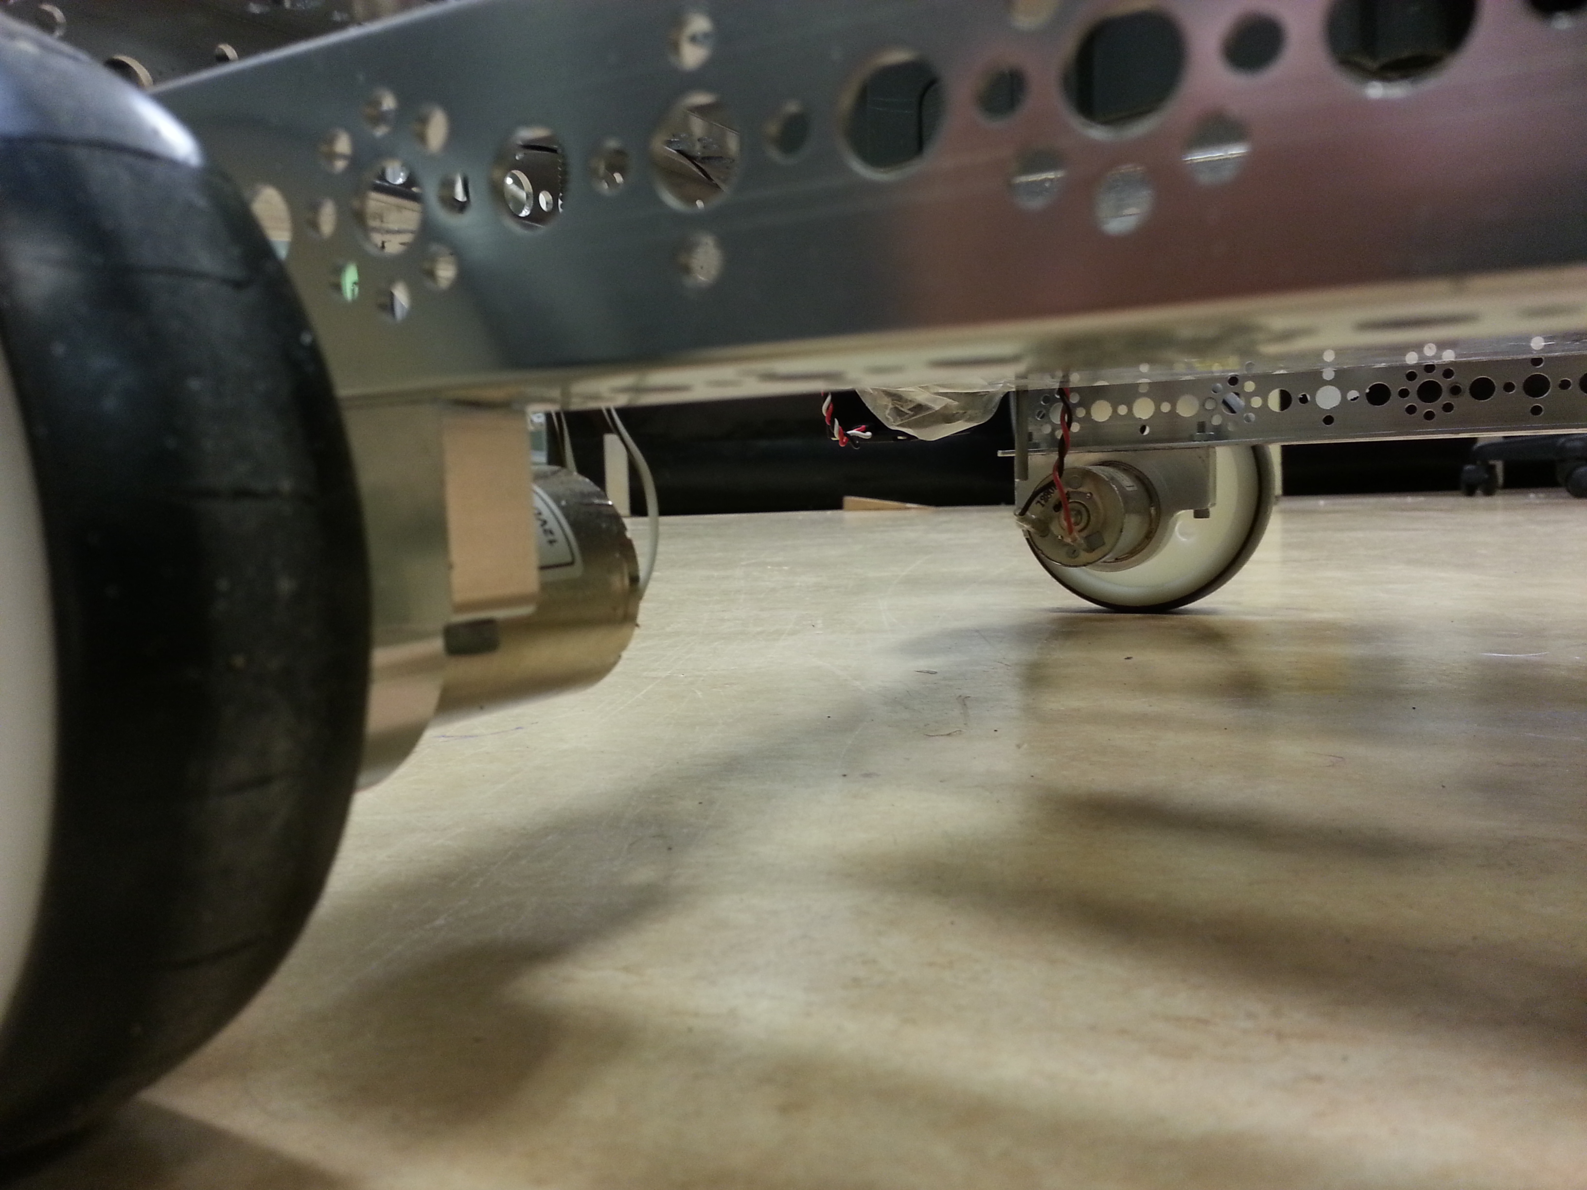
Wheels
Wheels are controlled with two DC motors
Each motor can independently move forward/backward
Forward
Backward
Left
Right

Slide 13
Move Wheel State diagram
f
b
FORWARD
BACKWARD
f
b
STOP
l
f
All inputs of (s) will move to this state
r
b
l
r
l
LEFT
RIGHT
r

Slide 14
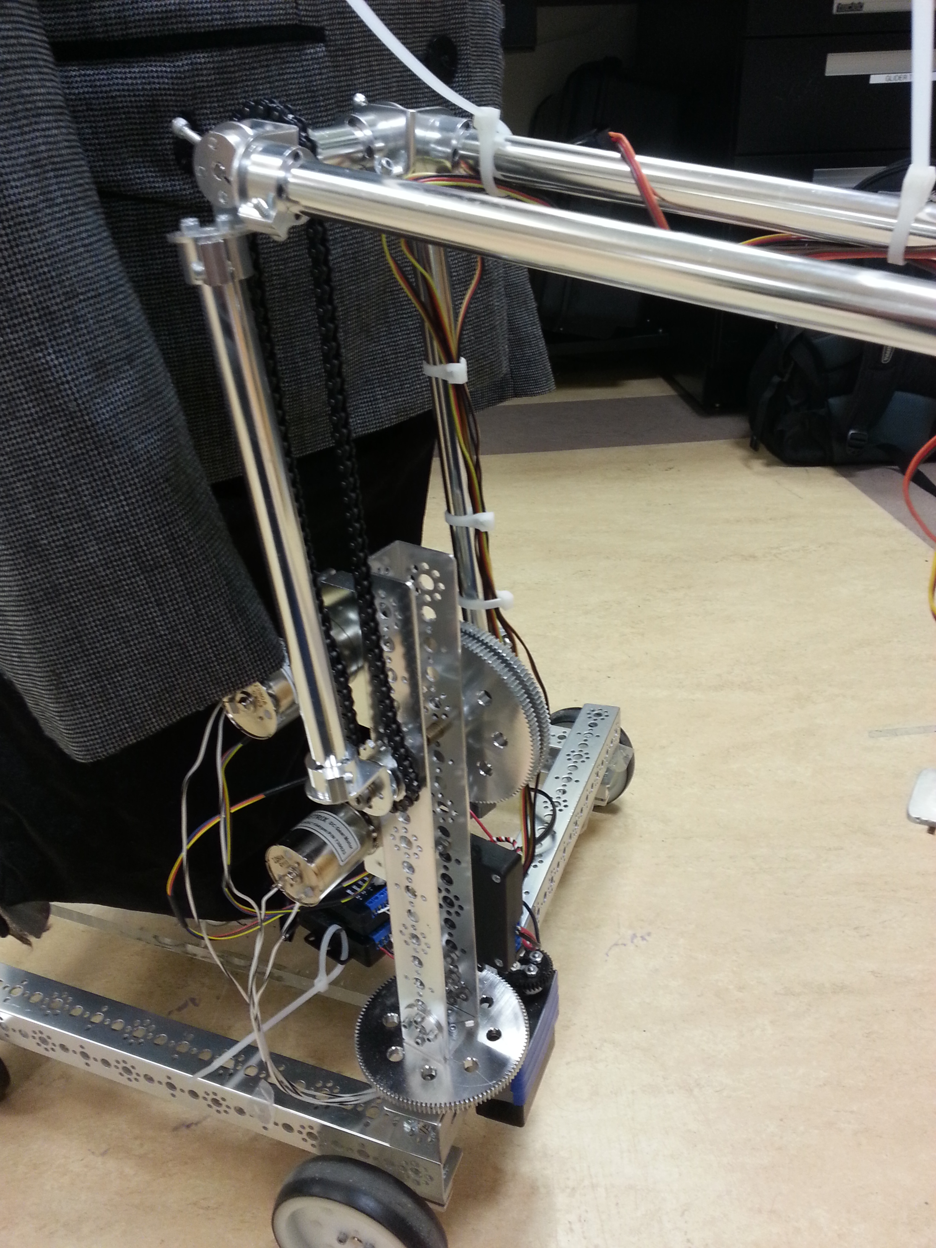
Arm
The Arm consists of the shoulder and the elbow
Shoulder has 2 DOF, elbow has 1 DOF
Elbow
Shoulder

Slide 15
ARM state diagram
SHOULDER LEFT
SHOULDER UP
ELBOW UP
IDLE
SHOULDER DOWN
ELBOW RIGHT
SHOULDER RIGHT

Slide 16
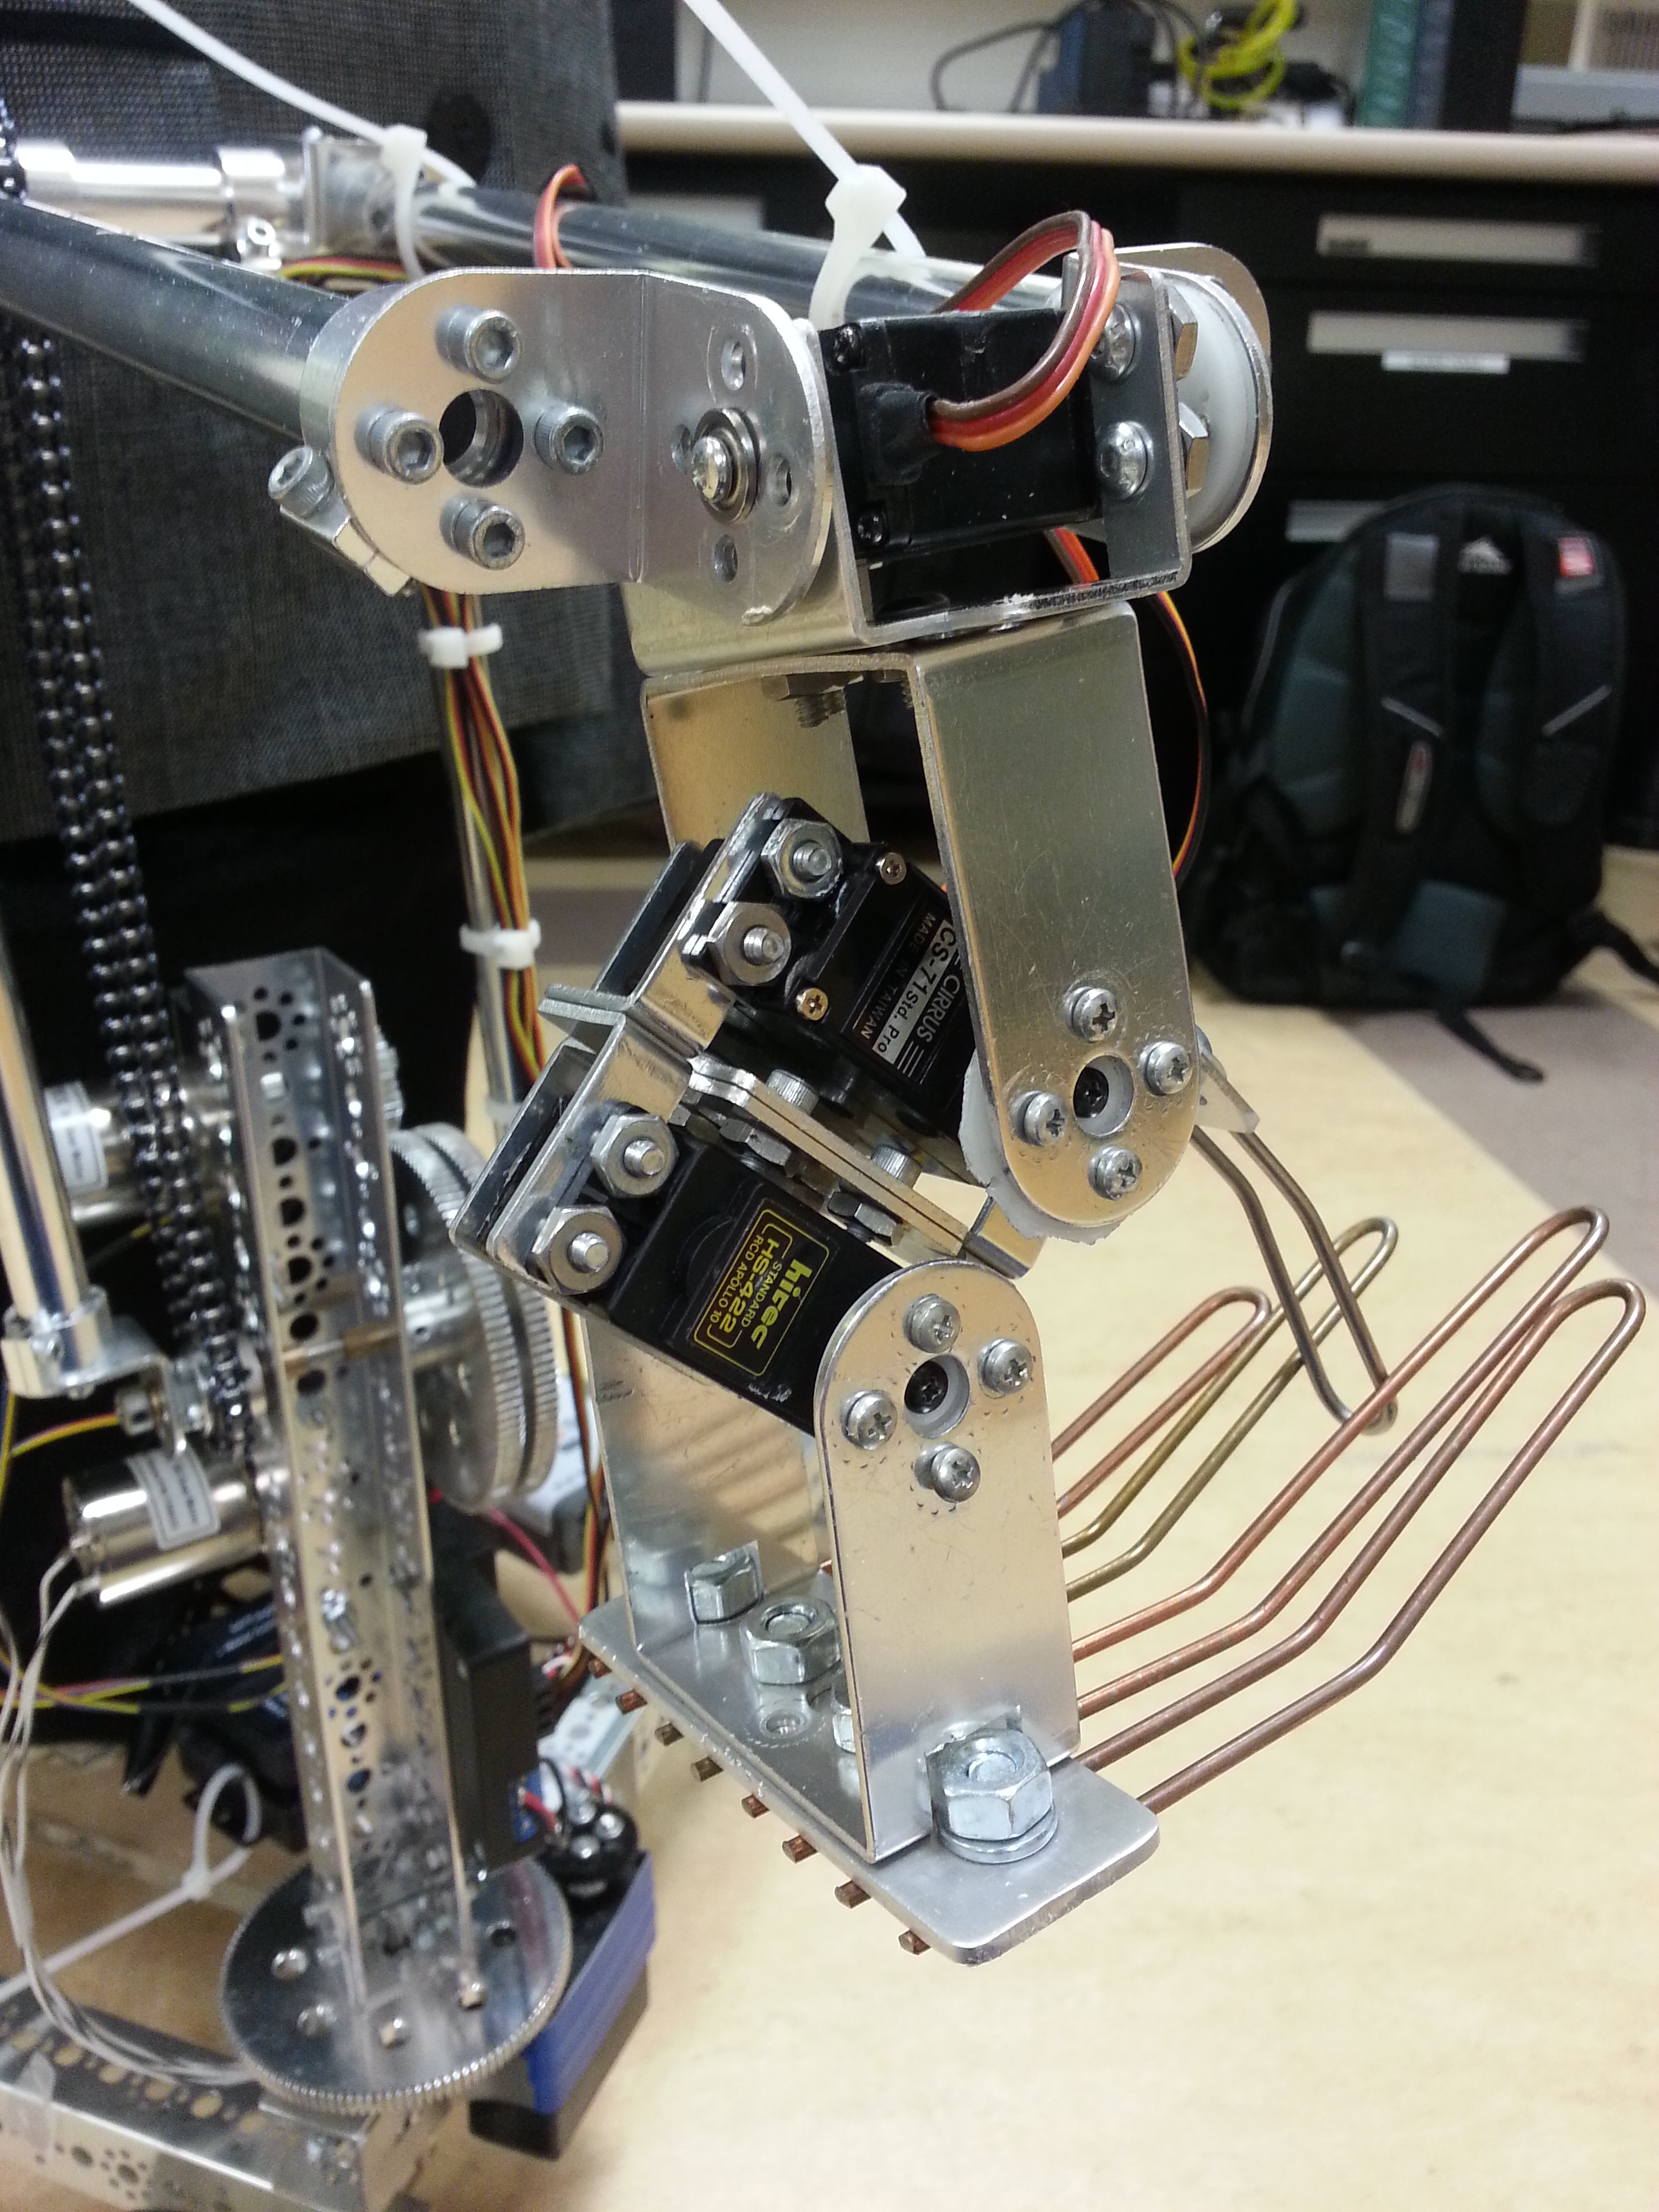
hand
The hand contains the wrist and the fingers
Wrist
Hand

Slide 17
Hand state diagram
WRIST UP
HAND OPEN
WRIST LEFT
IDLE
HAND CLOSE
WRIST RIGHT
WRIST DOWN

Slide 18
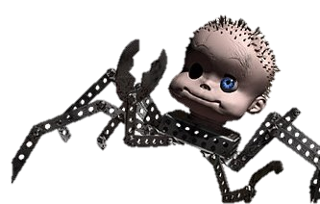
results
Complete motor control of robot
All motors and servos work
Complete control of arm with 6 degrees of freedom
Continuous motion servos swapped out for 180° servos
New body gives Bohr more potential
Looks more like a human, less like babyface

Slide 19
Results cont.
Robot can be controlled using keyboard input
Bluetooth communication is hidden, only need to input keystrokes
Robot can be controlled using Microsoft Kinect
Ability to switch between arm mode, hand mode, and drive mode

Slide 20
Technical problems
Original plan involved Kinect and laptop mounted on robot
Kinect requires 120VAC
Extension cords??? No thanks…
Tried to make the robot autonomous, but ours sensors were stolen…
Too much weight for 12VDC motors
Continuous rotation servos don’t work well in RobotC
Bad left/right shoulder servo

Slide 21
Future plans
Add parameter box in robot theater for people to be able to control Nixon Bohr
Add vision
Move arm to shoulder and add an identical arm on other side
Add facial emotion with IGA

Slide 22
Any questions?

